Slide 1

EDA Capstone Project
MAMTA SHARMA

Slide 2
Introduction
A few decades ago, traveling was not a part of everyday life. But today travel is an enormous budding industry of 8.8 trillion economy. This directly affects the hotel industry which is highly competitive.
We are here with a compact data to study about the hotel industry, mainly the booking. We are focussing on two types of hotels in this study. This data set contains different hotel types, countries located, guest, stays. Also the study have some factors that affect booking like wait time, lead time , months, average daily rate etc.
By the end we will conclude the study with following insights:-
Best time for booking
Optimal duration of stay
room type has the most demand and which room type generates highest adr.
Factors leading to cancellation which affects the revenue.
Factors like meals, parking spaces etc. which might affect in the increase of ADR and revenue.

Slide 3




Workflow
1
2
3
4
5
For this project we have used this workflow to analyse the hotel booking data

Slide 4
Attributes in the study
This data has 119390 rows and 32 columns. Here are the columns
Hotel
Is_cancelled
Arrival_date_year
Arrival_date_month
Arrival_date_week_number
Day_of_the_month
Stays_in_weekend_nights
Stays_in_week_nights
Adults
Children
Babies
Meals
Country
Market_segment
Distribution Channel
Is_repeated_guest
Previous_cancellations
Previous_bookings_not_canceled
Reserved_room_type
Assigned_room_type
Booking_changes
Deposit_type
Agent
Lead_time
Days_in_waiting_list
Customer_type
Adr
Required_car_parking_spaces
Booking changes
Reservation_status
reservation_status_date

Slide 5
Data Summary
Given data set has different columns of variables vital for hotel bookings. Some of them are:
hotel: The category of hotels, which are two resort hotel and city hotel.
is_cancelled : The value of column show the cancellation type. If the booking was cancelled or not. Values[0,1], where 0 indicates not cancelled.
lead_time : The time between reservation and actual arrival. stayed_in_weekend_nights: The number of weekend nights stay per reservation stayed_in_weekday_nights: The number of weekday nights stay per reservation. meal: Meal preferences per reservation.[BB,FB,HB,SC,Undefined]
Country: The origin country of guest.

Slide 6
Data Summary
market_segment: This column show how reservation was made and what is the purpose
of reservation. Eg, corporate means corporate trip, TA for travel agent, TO for Tour Operator
distribution_channel: The medium through booking was made.[Direct,Corporate,TA/TO,undefined,GDS.]
Is_repeated_guest: Shows if the guest is who has arrived earlier or not.Values[0,1]-->0 indicates no and 1 indicated yes person is repeated guest.
days_in_waiting_list: Number of days between actual booking and transact. customer_type: Type of customers( Transient, group, etc.)

Slide 7
Data Wrangling
Data Cleaning:-
Dropping Columns with Maximum Null values– agent and company
Dropping columns which had redundant values– Arrival_date_week_number
Columns with nominal null values have been manipulated by filling them with
Children column:- By Mean (Number of children)
Company & agent column:-By 0.0
Data Manipulation:-
Combining columns for an effective study
total_people=adults+children+'babies
total_stays= Stays_in_weekend_nights+Stays_in_week_nights

Slide 8

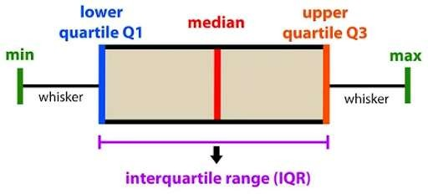
Handling Outliers
Interquartile range:-

Slide 9
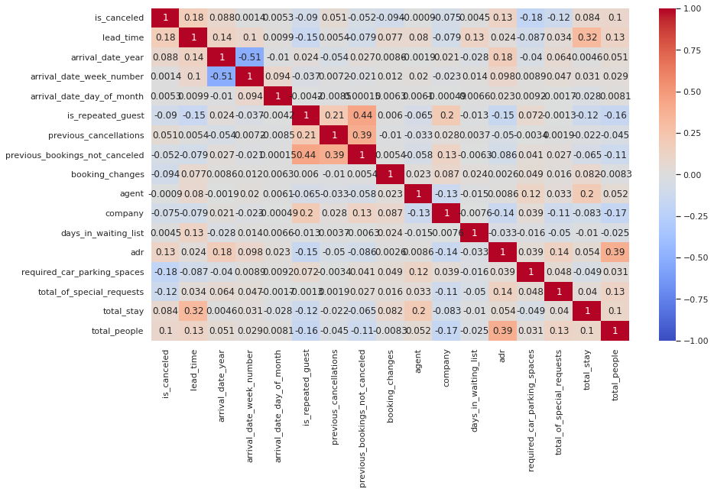
CORRELATION HEATMAP
We can observe that 'adr' has correlation with 'total_people' which means more the number of people, more is the revenue generated.
We can also see the correlation between 'lead_time' and 'total_stay' which implies that people spend more time to plan for a longer stay.

Slide 10
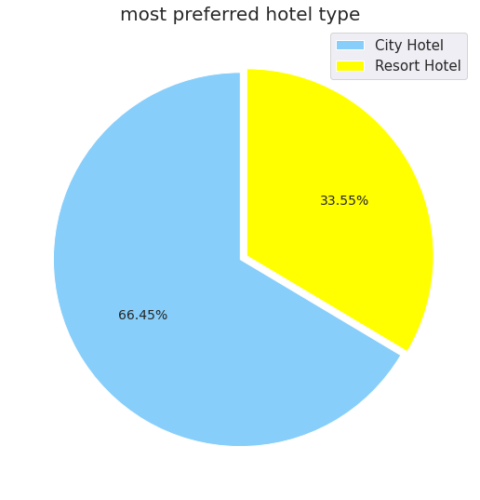
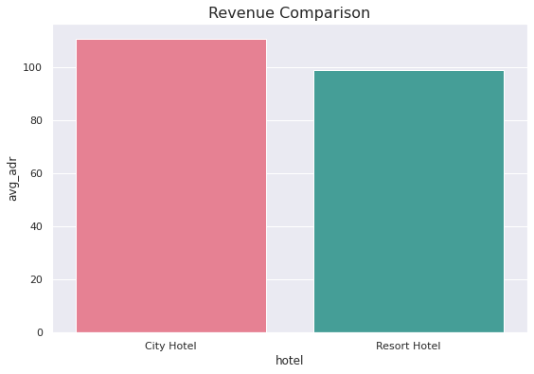
Percentage share of different hotel type and their revenue
City Hotels are most preferred hotel by guests.
Bookings are double for City hotel but the revenue difference is not much in between them.
This shows that Resort hotels are bit expensive as compared to City hotels

Slide 11
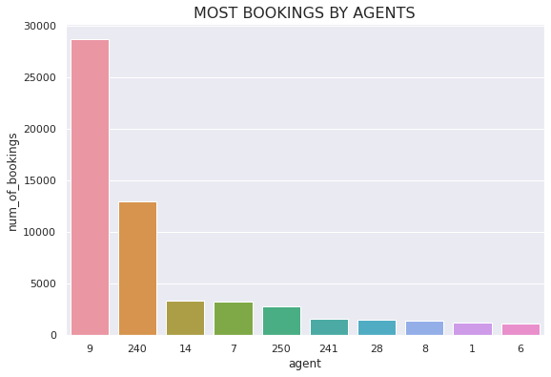
agent made most of bookings
Agent number 9 has made most number of bookings.

Slide 12
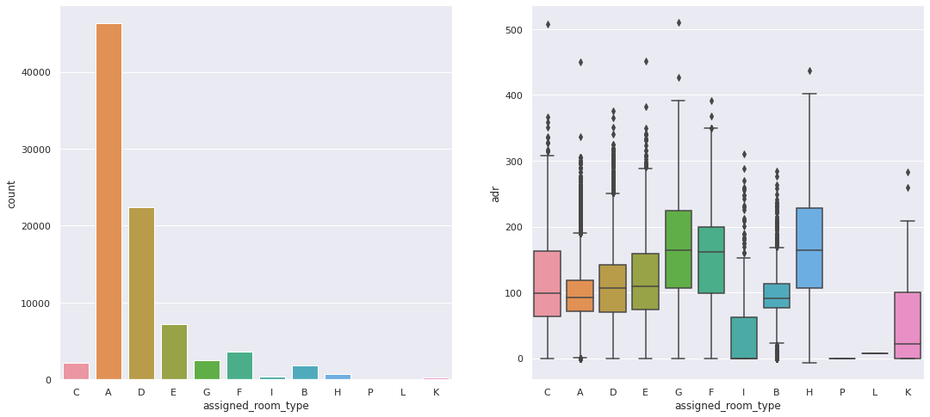
Preference of different room type
Majority of people prefers room type-A which seems to be more economical for booking as it has the least ADR. And ADR is higher for room type-H so lesser booking are made

Slide 13
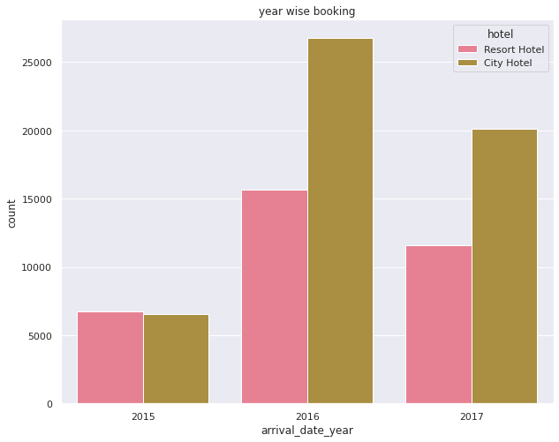
Yearly bookings
It seems that 2016 to be the year where the hotel bookings are highest. overall City hotels had the most of the bookings.

Slide 14
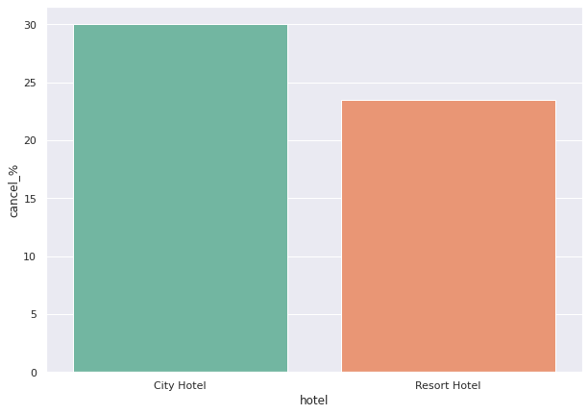
Cancellation made in each hotel
We can observe the negative growth here. Almost 30% cancellation at the city hotels is a cause of concern for the management. Certain measures need to be taken to reduce the cancelation rates.

Slide 15
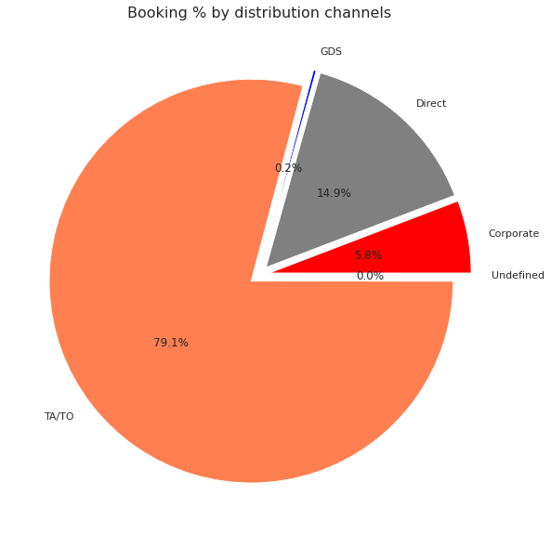
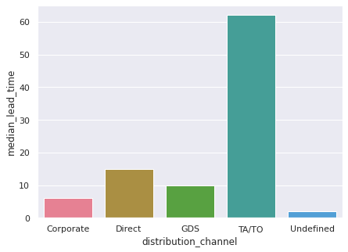
most common channel for booking hotels
The majority of customers make reservations through tour operators and travel agencies.
Second most popular channel is Direct.
Travel agents and tour operators are also used for early hotel bookings.

Slide 16
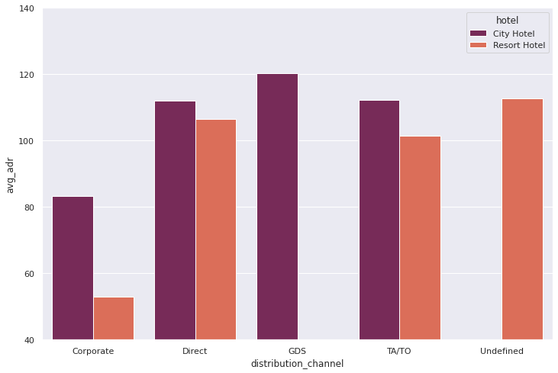
Better Revenue Generating Deals for Hotels
GDS channel brings higher revenue generating deals for City hotel, in contrast to that most bookings come via TA/TO. City Hotel can work to increase outreach on GDS channels to get more higher revenue generating deals.
Resort hotel has more revnue generating deals by direct and TA/TO channel. Resort Hotel need to increase outreach on GDS channel to increase revenue.

Slide 17
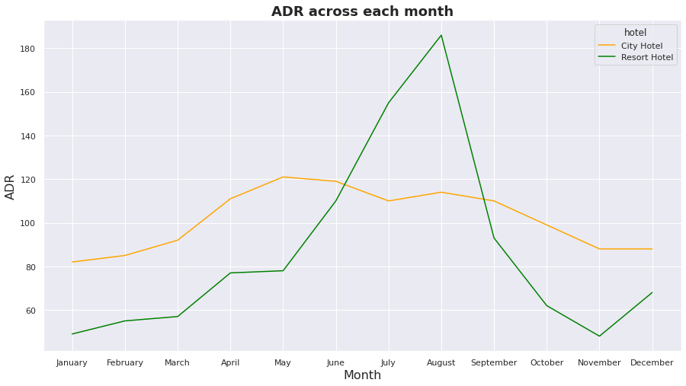
ADR of hotels in each month
For Resort hotel-- ADR is increasing between May to September and then started falling down, so best time to book a resort hotel is from October to April as we are getting lower ADR.
For City hotel--City hotels have nearly constant ADR from April to September and after that ADR start decreasing, so the best time to book a City hotel is from October to March.

Slide 18
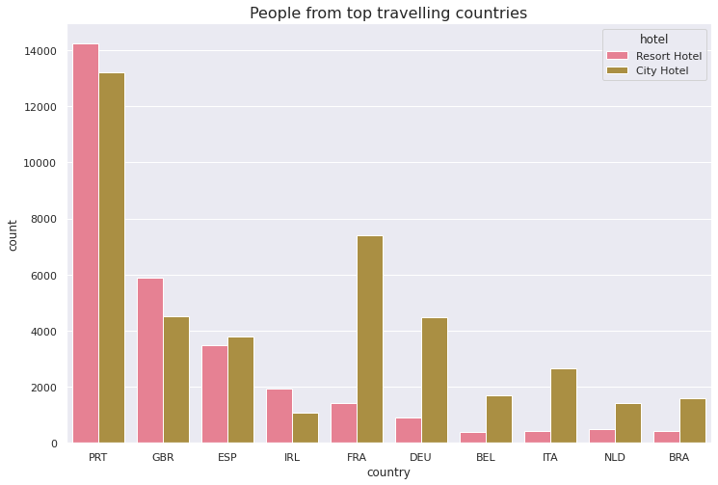
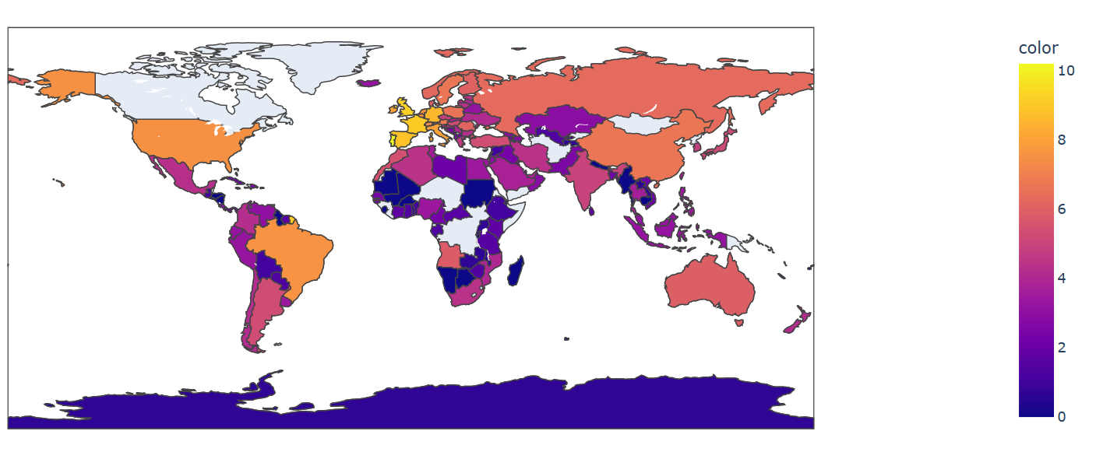
Analysis based on Country
Most number of guests are coming from Portugal and Great Britain.
The people from top 10 countries chooses Resort hotels over City hotel
agencies and Tour Operators compared to direct distribution channel.

Slide 19
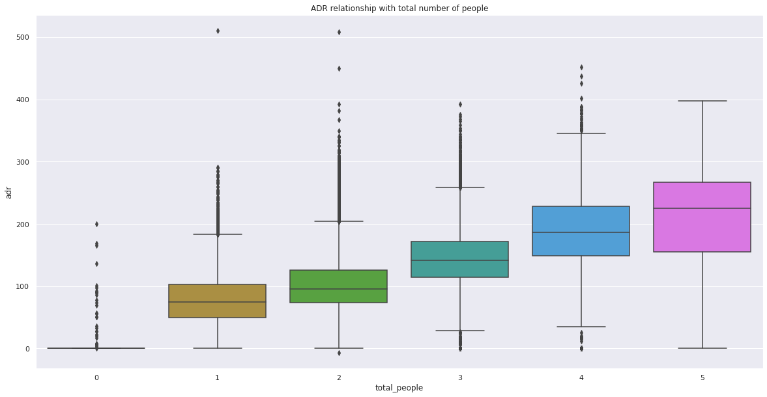
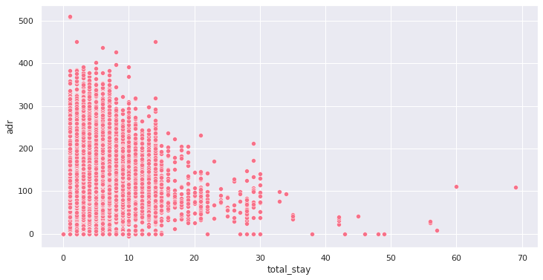
ADR relationship with total number of people & total_stay
As the total number of people increases adr also increases.
From the scatter plot we can see that as length of total_stay increases the adr decreases. This means for longer stay, the better deal for customer can be finalised.

Slide 20
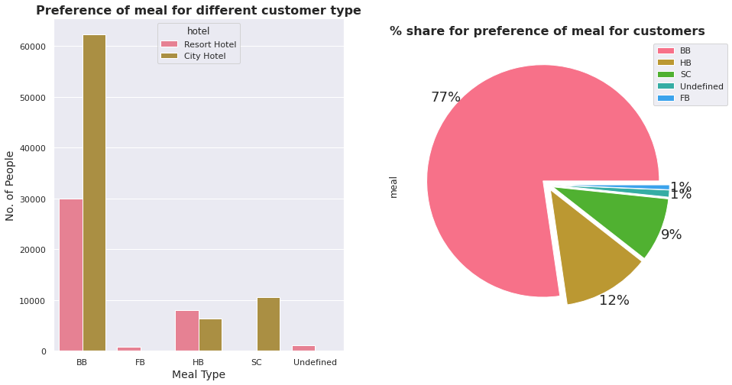
Analysis based on Meal
Most preferred meal by customer is BB for Resort and City Hotel
77% of the people prefer BB (bed & breakfast) meal type in both the hotel type.

Slide 21
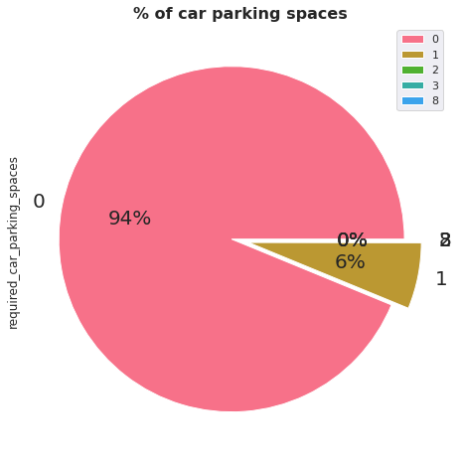
Analysis based on Car parking spaces
About 94% of people don’t shows their concern in car parking space while hotel bookings. Most of the customer don't require the car parking

Slide 22
Conclusions
Since the bookings are double for City hotel but revenue difference is less so Resort hotels are more expensive as compared to City hotels.
Agent number 9 has made most number of bookings.
Majority of people prefers room type-A which seems to be more economical for booking as it has the least ADR. And ADR is higher for room type-H so lesser booking are made
It seems that 2016 to be the year where the hotel bookings are highest. overall City hotels had the most of the bookings.
We can observe the negative growth here. Almost 30% cancellation at the city hotels is a cause of concern for the management. Certain measures need to be taken to reduce the cancelation rates.
The majority of customers make reservations through tour operators and travel agencies.
Travel agents and tour operators are also used for early hotel bookings.
GDS channel brings higher revenue generating deals for City hotel, in contrast to that most bookings come via TA/TO. City Hotel can work to increase outreach on GDS channels to get more higher revenue generating deals.
Resort hotel has more revnue generating deals by direct and TA/TO channel. Resort Hotel need to increase outreach on GDS channel to increase revenue.

Slide 23
Conclusions
Resort hotel has more revnue generating deals by direct and TA/TO channel. Resort Hotel need to increase outreach on GDS channel to increase revenue.
For Resort hotel-- ADR is increasing between May to September and then started falling down, so best time to book a resort hotel is from October to April as we are getting lower ADR.
For City hotel--City hotels have nearly constant ADR from April to September and after that ADR start decreasing, so the best time to book a City hotel is from October to March.
Most number of guests are coming from Portugal and Great Britain.
The people from top 10 countries chooses Resort hotels over City hotel
As the total number of people increases adr also increases.
for longer stay, the better deal for customer can be finalised.
Most preferred meal by customer is BB for Resort and City Hotel
77% of the people prefer BB (bed & breakfast) meal type in both the hotel type.
About 94% of people don’t shows their concern in car parking space while hotel bookings. Most of the customer don't require the car parking

Slide 24


